Slide 1

AOA PROJECT
PRESENTATION
OPTIMIZATION ALGORITHM
ADARSH MADIVALA
VAISHNAVI MAGADUM
BHAVYA PANDYA
SAKSHI PARADKAR
KRISHA PATEL

Slide 2


Types of Optimization Algorithms:
1.Classical (Deterministic): Usually efficient, good for convex problems.
Gradient Descent (GD).
2. Metaheuristic (Stochastic): Good for complex, non-convex, NP-hard problems
Genetic Algorithm (GA), Simulated Annealing (SA), Particle Swarm Optimization (PSO).
An optimization algorithm is a method or procedure used to find the best possible solution (maximum or minimum) to a problem from a set of feasible solutions, under given constraints.
What is an Optimization Algorithm?

Slide 3

Iterative optimization algorithm that updates parameters in the direction of the negative gradient of the objective function until convergence.
Instead of strictly following the gradient, Simulated Annealing (SA) explores the parameter space by accepting not only better solutions but sometimes worse ones, depending on a "temperature" that cools over time. This helps escape local minima.
Gradient Descent (GD)
Simulated Annealing (SA)
Time Complexity = O(k⋅n⋅d)
k = number of iterations
n = number of samples
d = number of features
Time Complexity = O ( k ⋅ f )
k = number of iterations/temperature steps
f = cost of evaluating the objective function

Slide 4
Genetic Algorithm (GA)
It is an optimization technique inspired by natural selection and genetics. It evolves a population of candidate solutions using selection, crossover, and mutation to gradually improve fitness.
Convex problems
(e.g., least squares, logistic regression with convex regularizers) have one global minimum. Any local minimum is global; descent methods are reliable.
Non-convex problems
(e.g., deep nets, matrix factorization, feature selection, Rastrigin) have many local minima and saddle points; global optimality is hard (often NP-hard).
Time Complexity = O(G⋅(P⋅f + P logP))
G = number of generations
P = population size
f = cost of evaluating fitness per individual

Slide 5



Apply Optimization to Logistic Regression using Student Performance Dataset
COMPARE
Gradient Descent
Simulated Annealing
Genetic Algorithm
V/S
V/S.
Gradient Descent is highly efficient for convex problems like student performance prediction, converging quickly with time complexity O(n·d·k).
Metaheuristic algorithms (SA, GA) are slower and computationally expensive, as they explore large solution spaces iteratively. For convex, differentiable problems, GD is faster, scalable, and more practical.

Slide 6

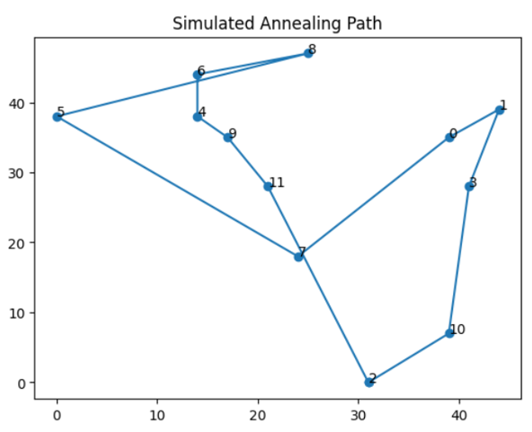
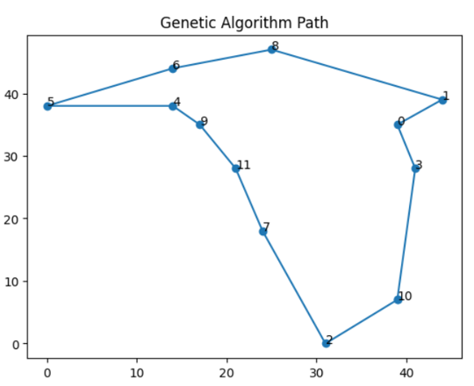


Traveling Salesman Problem
A salesman must visit a set of cities exactly once, return to the starting city, and minimize the total travel distance (or cost)
COMPARE
Simulated Annealing (SA) is preferred for fast, near-optimal solutions.
Genetic Algorithm (GA) is ideal when high accuracy and cost minimization are critical, despite longer computation.

Slide 7

Thank you!
Analysis Of Algorithms

